Slide 1
DNS/DPS presentation
(a sequential version)
DNS : direct numerical simulation of the carrier phade
DSP : Discrete Particle Simulation
- All the variables are dimensionless
A tangent hyperbolic law is applied in the wall normal direction
Periodic conditions are applied in the streamwise and spanwise directions

Slide 2
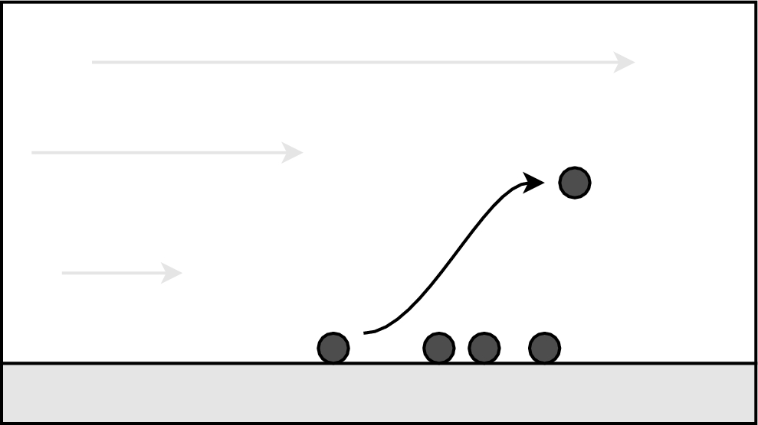
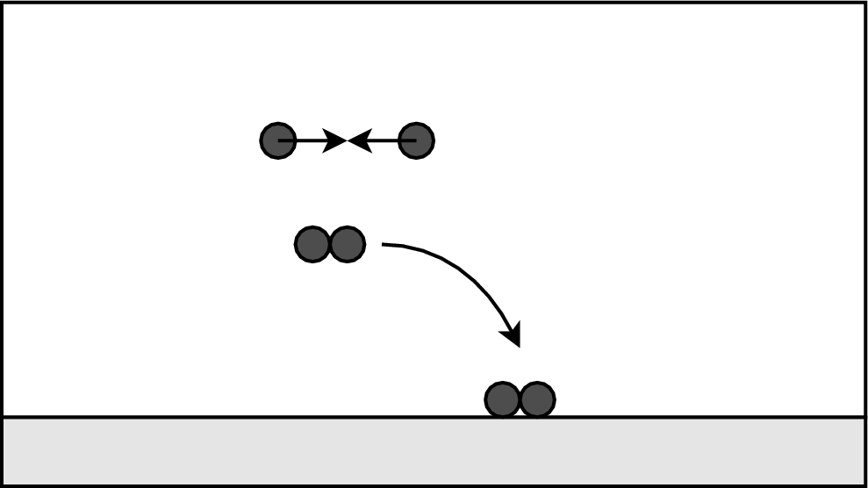
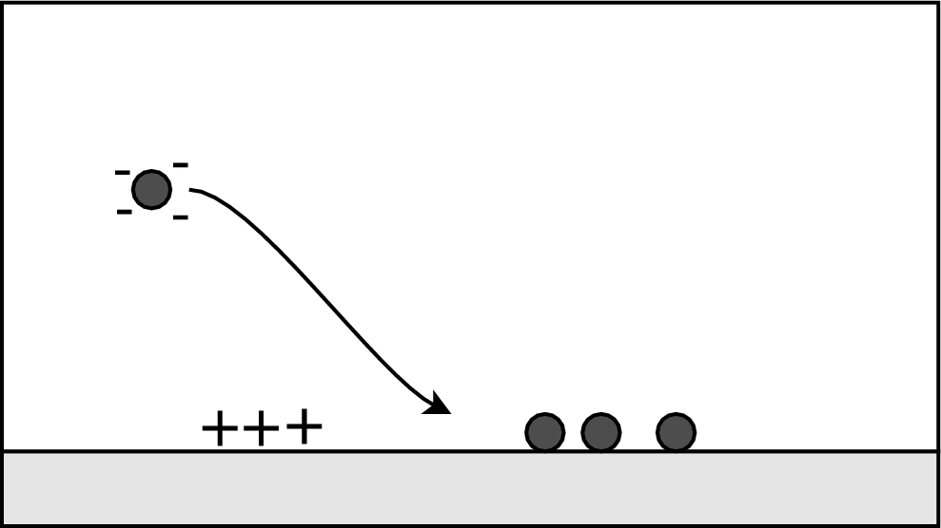
Purpose : Study of the behavior of particle/turbulence interactions of solid particles in an inhomogeneous turbulent flow with and without heat transfer. We propose to study such interactions by decomposing them in simple mechanisms as dispersion, agglomeration ( and /or fragmentation), resuspension and deposition.
D ispersion
D éposition
R esuspension
A gglomeration
Why ?
  ♦ Better understanding the physical phenomena
  ♦Closure assumptions for eulerian-eulerian and eulerian-lagrangian modeling approach
How?
By means of a direct numerical simulation of the carrier phase (a turbulent channel flow)
coupled with a particle Lagrangian tracking (DNS/DPS code ).

Slide 3
History of the DNS/DPS Code
1997: Fluid solver from Paolo Orlandi (a sequential version)
Preliminary steps
Preliminary studies for the heat transfer
DNS/DPS code with heat transfer and two-way coupling
I- Development of fluid energy equation solver and introduction of the heat transfer between phases.
Development of lagrangian particle tracking : start of the studies on particle dispersion and deposition (drag, lift and electrostatistics forces are taken into account)
Towards a heated turbulent channel flow from a (bibliography analysis)
(B. Arcen, Phd Student )
II- The two coupling effect
(R.Vernet, Master, 2005)
(P. Rambaud, Phd Student)
[R. Reigner, A. Collin,
B. Arcen (Master)]
1997
2001
2003
2006
2012: Towards a parallelized version ?

Slide 4
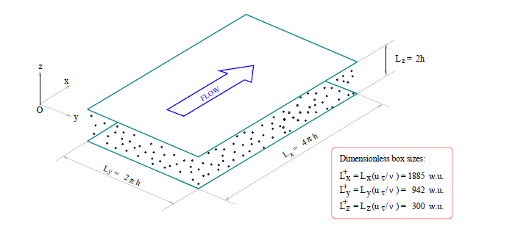
Lagrangian particle tracking in a turbulent flow: theory

Slide 5
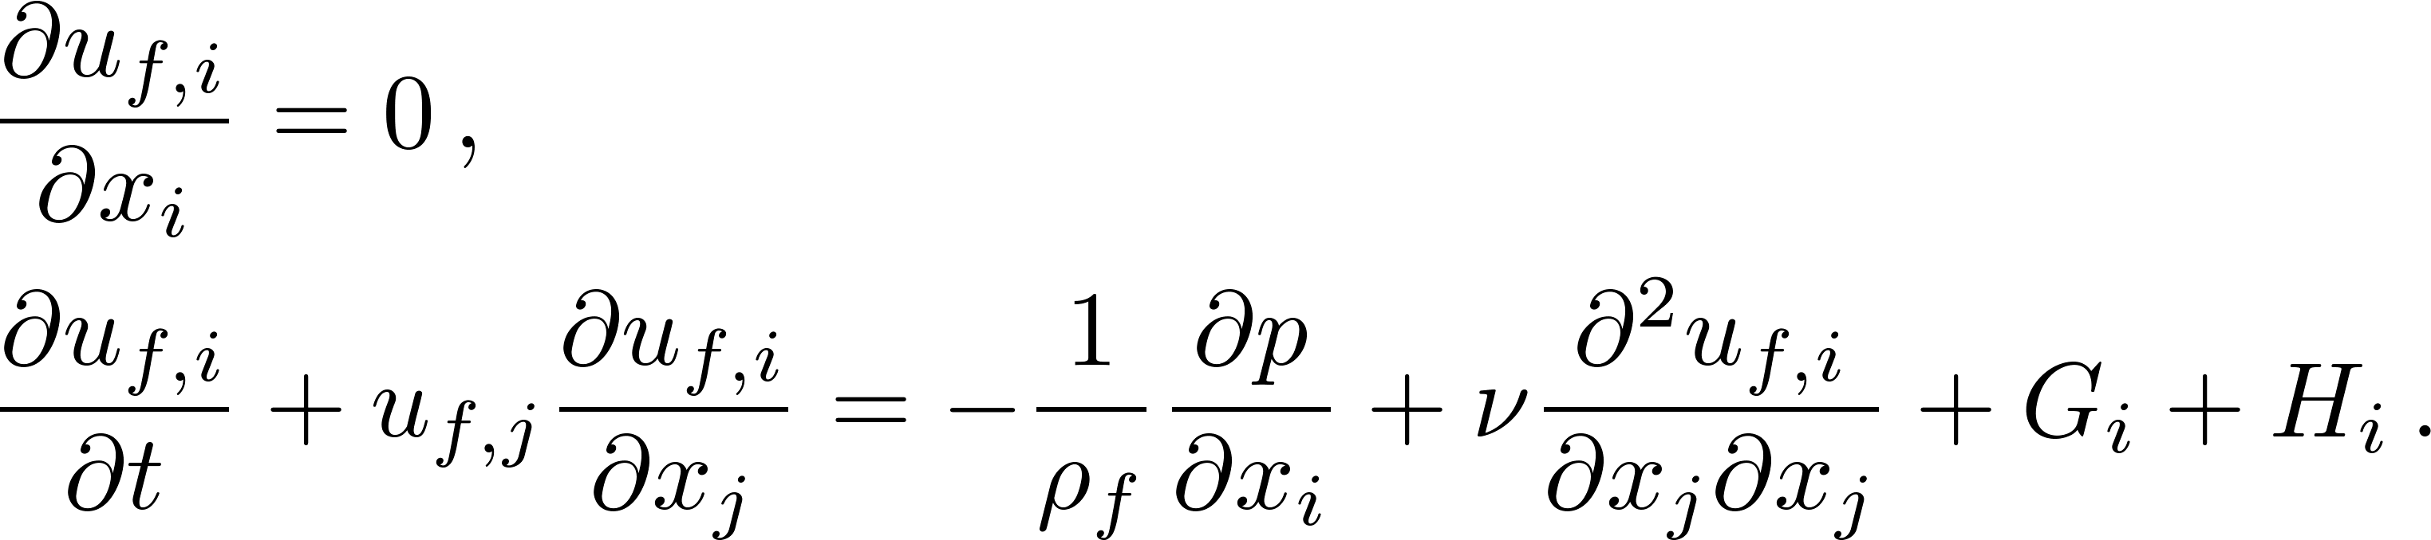
Governing equations and numerical methods
For the carrier phase
+ Boundary conditions [no-slip, non penetrating and periodicity conditions]
G_{i} is the forcing term needed to keep a constant flow rate
H_{i} is the momentum coupling term (feedback from the particles)
  Numerical methods :
    Fractional step method (Verzicco & Orlandi, 1996)
    Second order finite difference schemes,
    Crank-Nicolson / third order Runge-Kutta.
::<number>::

Slide 6
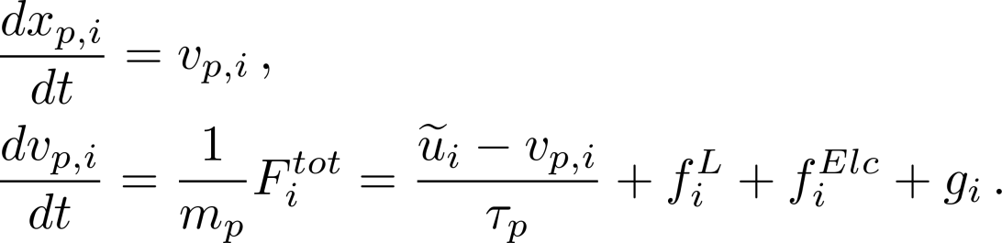
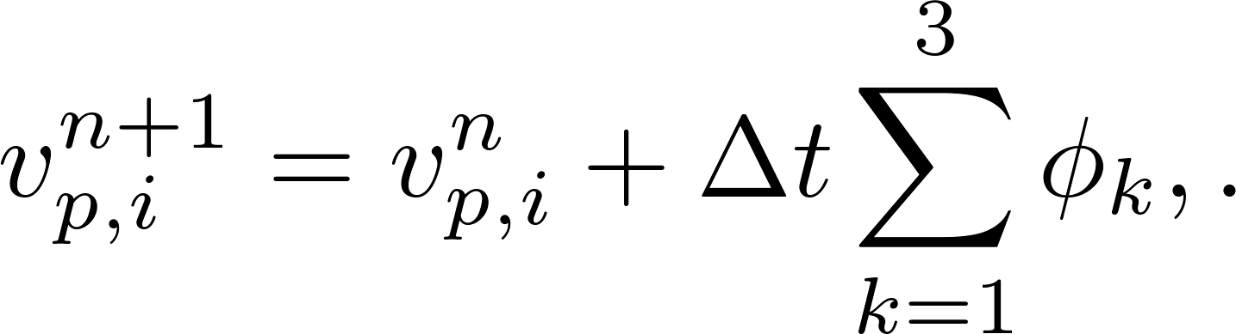
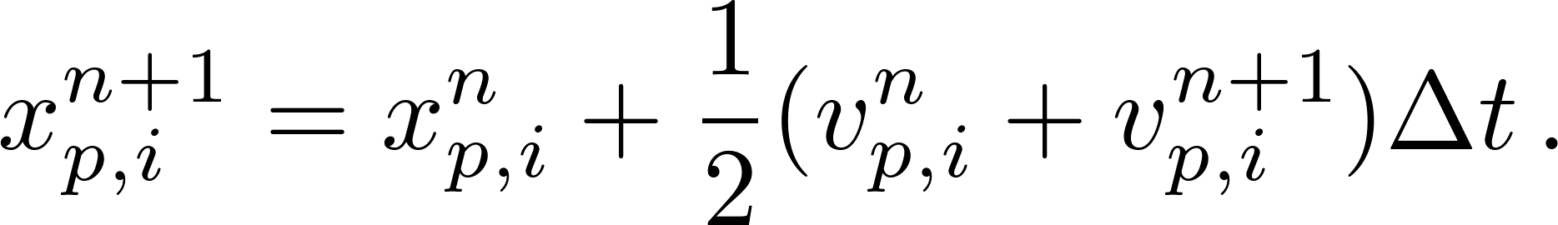
For the dispersed phase
+ Boundary conditions (particle/wall collision and periodicity conditions)
where f^{L} is the lift force and f^{Elc} is the electrostatic force .Note that the forces are corrected to take the presence of the wall into account !
  Numerical methods :
    Third order Runge-Kutta for the velocity,
    Trapezoidal method for the position (for each RK sub-steps)

Slide 7
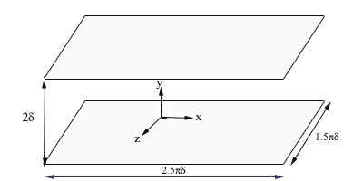
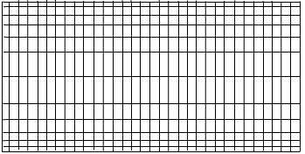
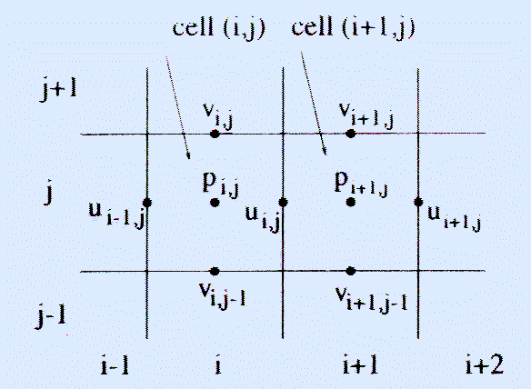
Flow characteristics
•
•
Computational Domain:
•
Mesh:
–
Tangent hyperbolic law in (oy)
–
Periodic conditions
in Ox et Oz
directions

Slide 8
Hermit interpolation
64 equations
64 unknows

Slide 9
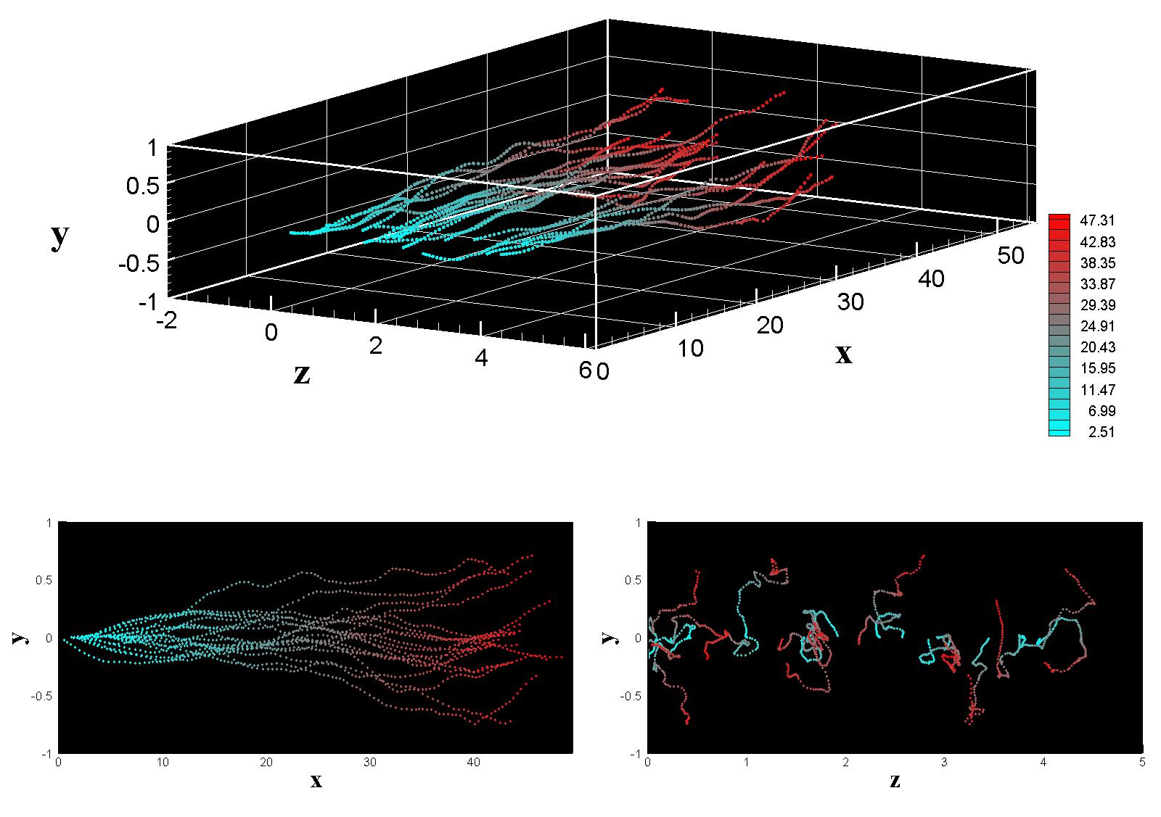
What can do the present code (see INPUT5)
Solid particles:
  - Track particles in a turbulent flow under one-coupling assumption
  Heated particle laden channel flow (imposed temperature at each wall) can be computed
  ♦Solve the fluid energy equation
  ♦Simulate the heat transfer between the fluid and dispersed phases (one-way coupling)
  - Can simulate two-way momentum coupling (not fully validated)
Fluid particles:
♦Track fluid particles in a turbulent flow

Slide 10
What can do the present code ( Cont’d…)
Post processing (statistics computation)
  For the fluid
    One point statistics:
      - Mean, variance, skewness and flatness for the velocity and the pressure
      - Mean, variance of the temperature
      - Turbulent heat fluxes
    Two time statistics:
    - time decorrelation of the fluid velocity and temperature
      ♦ eulerian point of view (at fixed point)
      ♦ lagrangian point of view (following fluid particles) time scales
      Development of post processing programs
    ♦ Computation of the budget elements of the Reynolds transport equation
    Calculation of the spatial correlation
    ♦ Coherent structures (criteria Q, λ2, ) and swirling strength

Slide 11
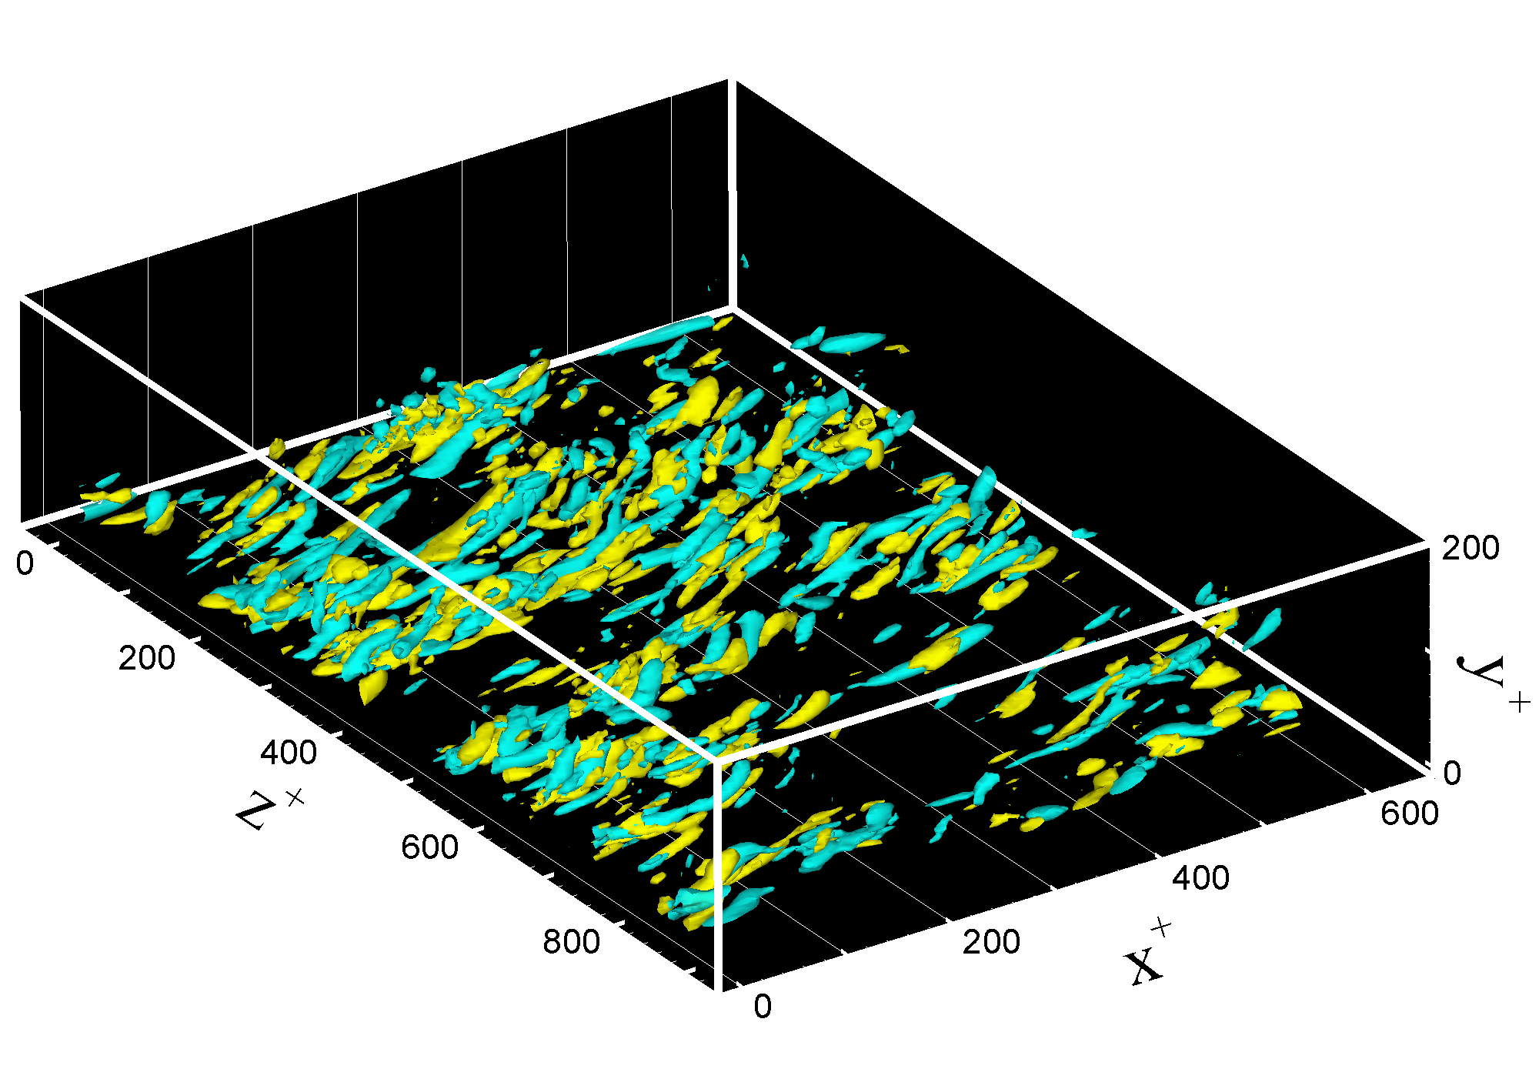
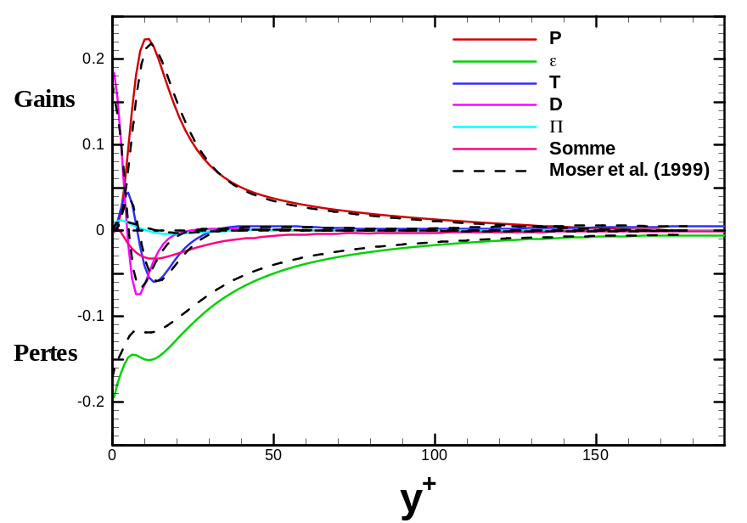
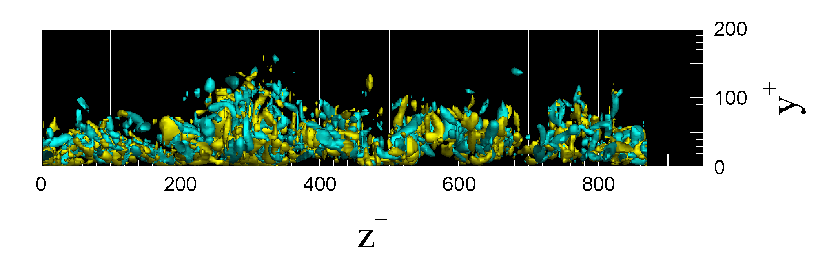
What can do the present code ( Cont’d…)
Post processing (statistics computation)
T.K.E. Balance
Q criteria

Slide 12
What can do the present code ( Cont’d…)
Post processing (statistics computation)
For the solid particles:
  ♦concentration, mean and variance for the velocity and temperature.
  ♦Triple velocity correlations.
Fluid-particle statistics :
Velocity ant temperature covariances
Mean and variance of the relative velocity
For the fluid at solid particle location (‘fluid seen”)
  One point statistics:
    - mean, variance for the velocity and the temperature of the fluid seen
    Two time statistics:
        - time decorrelation of the fluid velocity and temperature seen by particles.

Slide 13
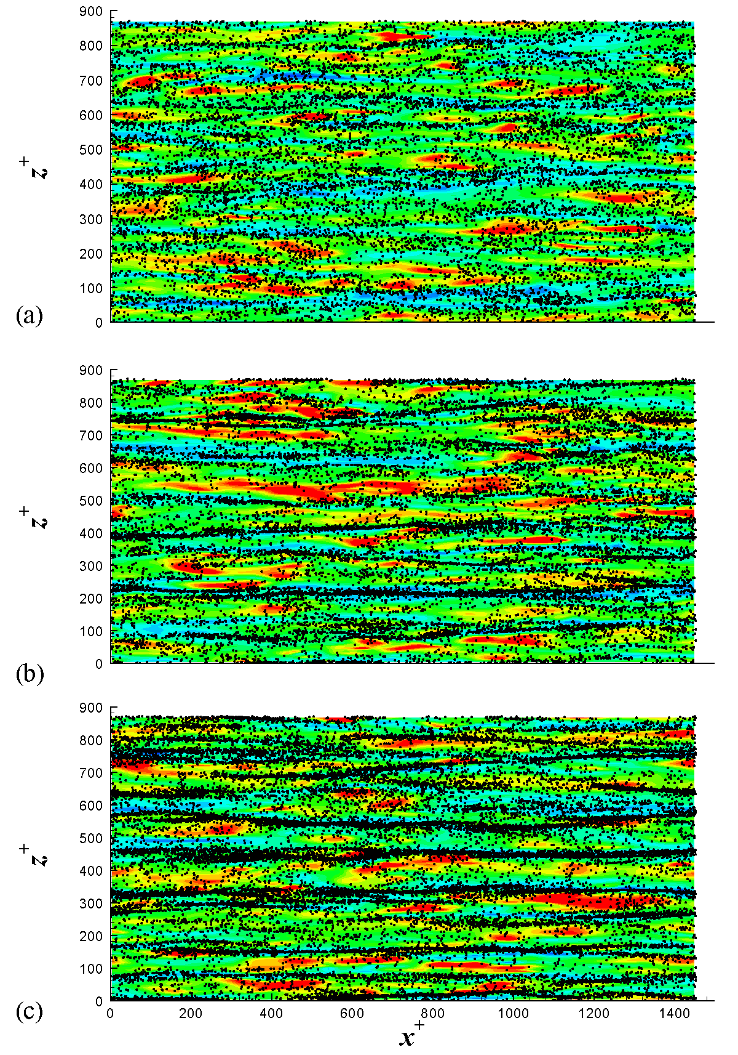
For the fluid at solid particle location
(‘fluid seen”)
Instantaneous particle distribution
in (x,z)-slice (1< y+ < 4.2 ) for three
particle inertia

Slide 14
What are the next steps ?
Physical objectives
  Introduce particle/particle interaction (collision and agglomeration)
  Validate the two way momentum coupling and introduce the Thermal two-way coupling
  Increase the Reynolds numbers
Numerical objectives
  Parallelization of the DNS/DSP code in order to compute the higher Reynolds number channel flow

Slide 15
Lagrangian tracking : algorithm

Slide 16
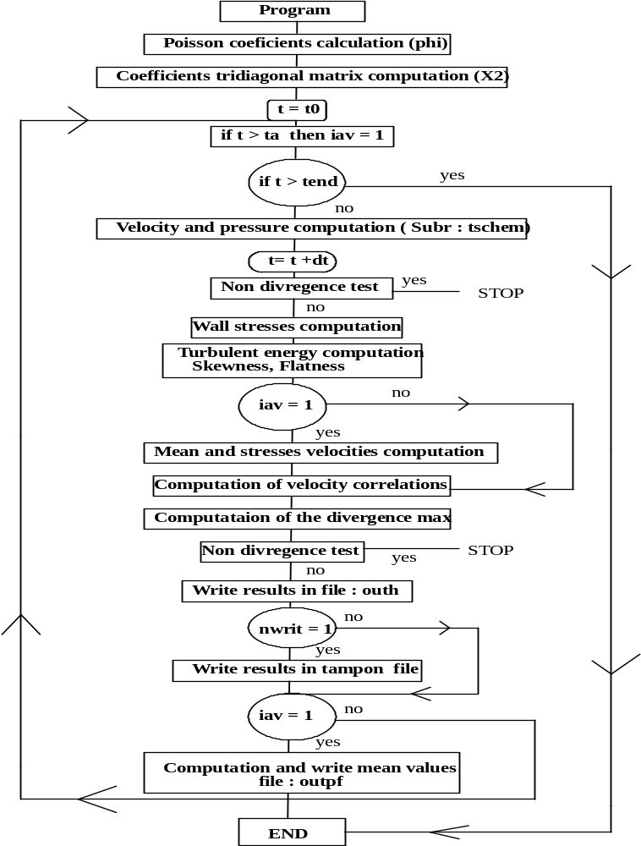
Particle_package
(located in partmain.f and called by sub time_scheme)
if t= t0_part then
- Particle Initialisation
If t ≥ t0_part then
- Solve particle equation of motion
- Compute particles statistics

Slide 17
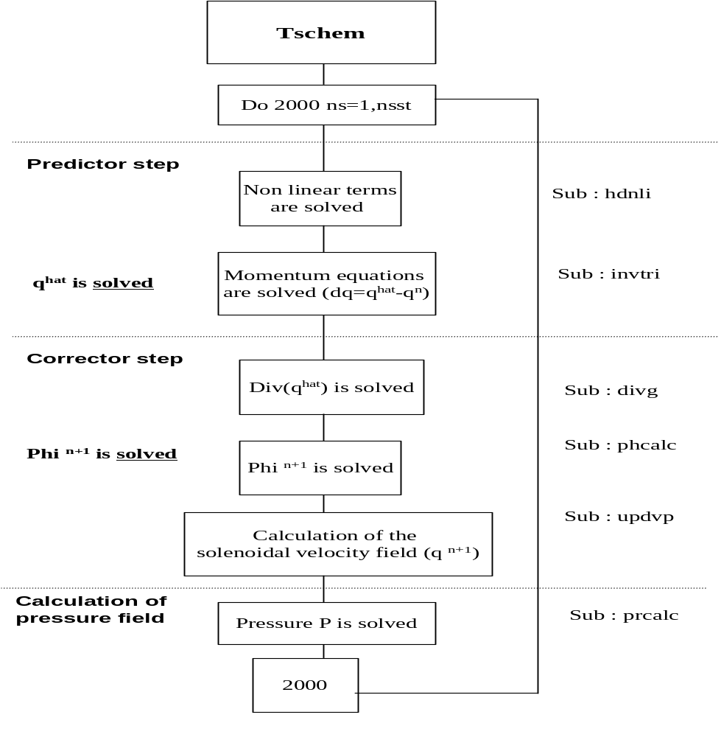
Solve particle Equation of Motion ( in sub Time_scheme)
Particle equation of motion is solved for each Runge-Kutta sub-steps (nsst = 1,3)
Call to particle-package

Slide 18
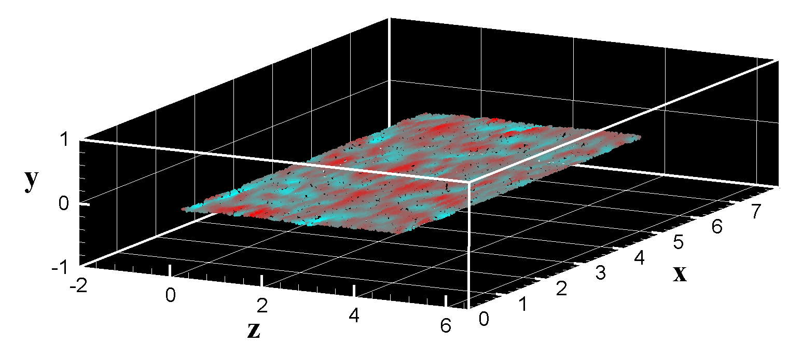
Particle initialisation
Subroutine particle_initialisation in partini.f
Initialize the particle location in the channel
  There are 8 different ways to do it (e.g. in a slab parallel to the wall)
Initialize the particle velocity
  Initial particle velocity = velocity of fluid interpolated at the particle location (Hermite Interpolation)

Slide 19
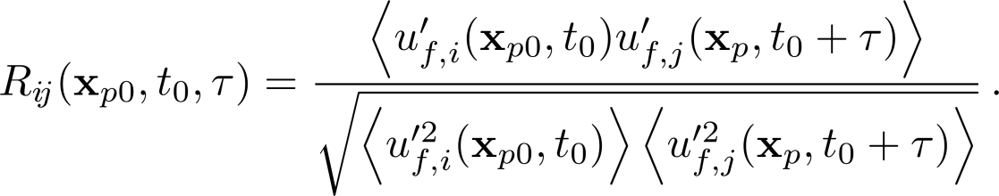
Time-integration of the particle equation of motion and statistics
Subroutine particle_package in partmain.f
Interpolation of the fluid velocity at particle location (Hermite)
Compute the forces acting on the particles
Update the particle velocity
Update particle position knowing the new velocity
Apply boundary conditions for the particle (wall collision and periodicity)
In particle-Package, there are also:
Call to a lagrange_velo_stat to compute the one point particle statistics (mean, variance of the particle velocity, fluid-particle covariance, etc.),
Call to dispersion_routine to compute two-time statistics (time decorrelation of the fluid seen by particles)

Slide 20
Particle package algorithm
SUBROUTINE PARTICLE_PACKAGE(q,Tem,ntime,al,ga,ro)
dans partmain.f
Solve the NS equations
t ≥ t0_part
yes
t = t0_part
yes
Particle initialization(partini.f)
Fluid velocity interpolation at particle location (partinter.f)
Force computation (partdrag.f & partlift.f)
Update particle velocity
(partlagrange.f)
Update particle position
(partlagrange.f)
Apply boundary conditions if necessary
Compute particle statistics

Slide 21
2012: Towards a parallelized version ?
DNS solver
Differents codes (Thetis, Openfoam, spectral methods..)
(differents grids and numerical technics )
DNS
Interface
DPS
Pressure, Instantaneous fluid velocity fied
Objective: develop a parallelized DPS SOLVER which can be coupled with any parallelized DNS solver
What is the best strategy ?

Slide 22
DSP solver : a modularize code
► READ the flow field statistics issued from DNS SOLVER
at different time steps
► Managing the particle initialization in the flow field
Nota Bene: Parallelization of the Lagrangian Tracking routine has to account for the non homogeneity of particle concentration distribution in the flow field but also has to
accounting a further possibility to treat the coupling effect between phases.
► Fluid velocity interpolation at particle location
► Solve particle equation of motion (update position and velocity)
Important: the choice of the temporal integration scheme to solve the equation of particle motion implies the kwnoledge of different fluid velocity fieds at different time setps
(Example: « t-Δt » and « t » for an Adams Basforth scheme)
► Particle boundary conditions (wall and periodic conditions)
► Compute particle statistics

Slide 23
► READ the flow field statistics issued from DNS SOLVER at different time steps.
DEPENDS ON THE GRID USED IN DNS SOLVER (collocated grid, stagerred grid..)
( dimensionless equations or not ?) (u, v, w HAVE TO BE STORED in an array q(3, m1, m2, m3)
The dimensions of the numerical domain have to be known
Read the data :
number of points (n1, n2, n3 , n1m (n1-1), n2m, n3m
dimension of the domain L1, L2, L3
mesh coordinates x1, x2, x3
Which has to be known beforehand:
include parameter.f ( nodes number, particles number)
common/dim/n1,n1m,n2,n2m,n3,n3m
common/ mesh/ dx1, dx2, dx3
common/coordi/ x1(m1), x2(m2), x3(m3)
common/d13/ alx1, alx3 (dimensions in spanwise and longitudinal periodic directions)
common/tstep/ Δt, reynolds number
common/pdensity/ rof ?
common/ bulk-velocity/ Ub ?
common/half channel/ delta ?
dimension q(3, m1, m2, m3) (m*: nodes number in each direction) at different time steps

Slide 24
► Managing the particle initialization in the flow field
Which has to be known beforehand:
include parameter.f ( nodes number, particles number)
common/dim/n1,n1m,n2,n2m,n3,n3m
common/d13/ alx1, alx3 (dimensions in spanwise and longitudinal periodic directions)
common/tstep/ Δt, reynolds number
common/fdensity/ rof ?
common/ bulk-velocity/ Ub ?
common/half channel/ delta ?
dimension q(3, m1, m2, m3)
common/pdensity/ rop
common /part/np, dp ( number of particles and particle diameter)
common/partcoord/ x1(mp), x2(mp), x3(mp) ( mp: total number of particles)
common/partvelo/vp1(mp), vp2(mp), vp3(mp)
common/pintvel1/vf1(mp), vf2(mp), vf3(mp) (fluid velocity at particle location)
INITIAL PARTICLE POSITION. Example : stochastic position of particles in the channel flow (n-seeding=1 in the sequential code)
x1(n) = rand(0)*alx1 n : indice of particle (1, 2 …, mp)
x2(n) = 0.95*(2.*rand(0) - 1)
x3(n) = rand(0)*alx3
INITIAL PARTICLE VELOCITY : Fluid velocity interpolated at the particle location
CALL INTERP1(q,n,n) → vp1(n) = vf1(n)
CALL INTERP2(q,n,n) → vp2(n) = vf2(n)
CALL INTERP3(q,n,n) → vp3(n) = vf3(n)

Slide 25
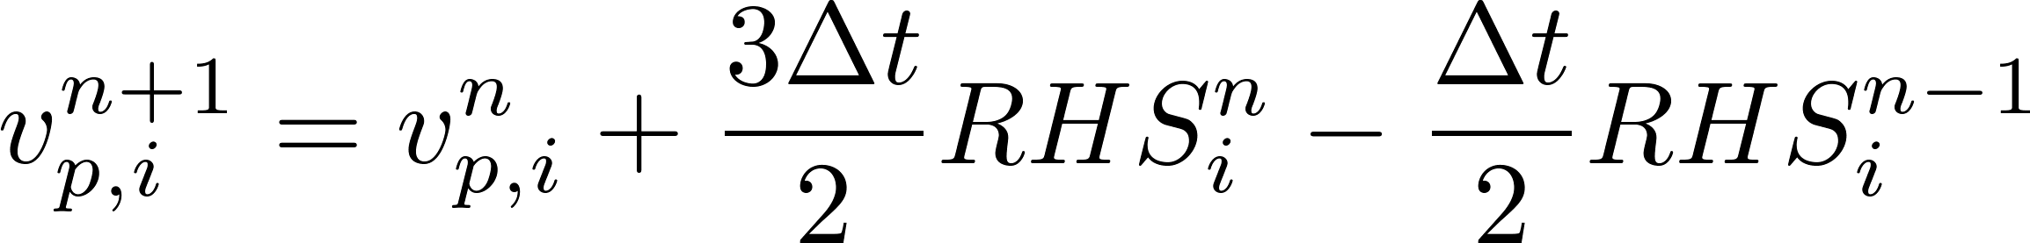
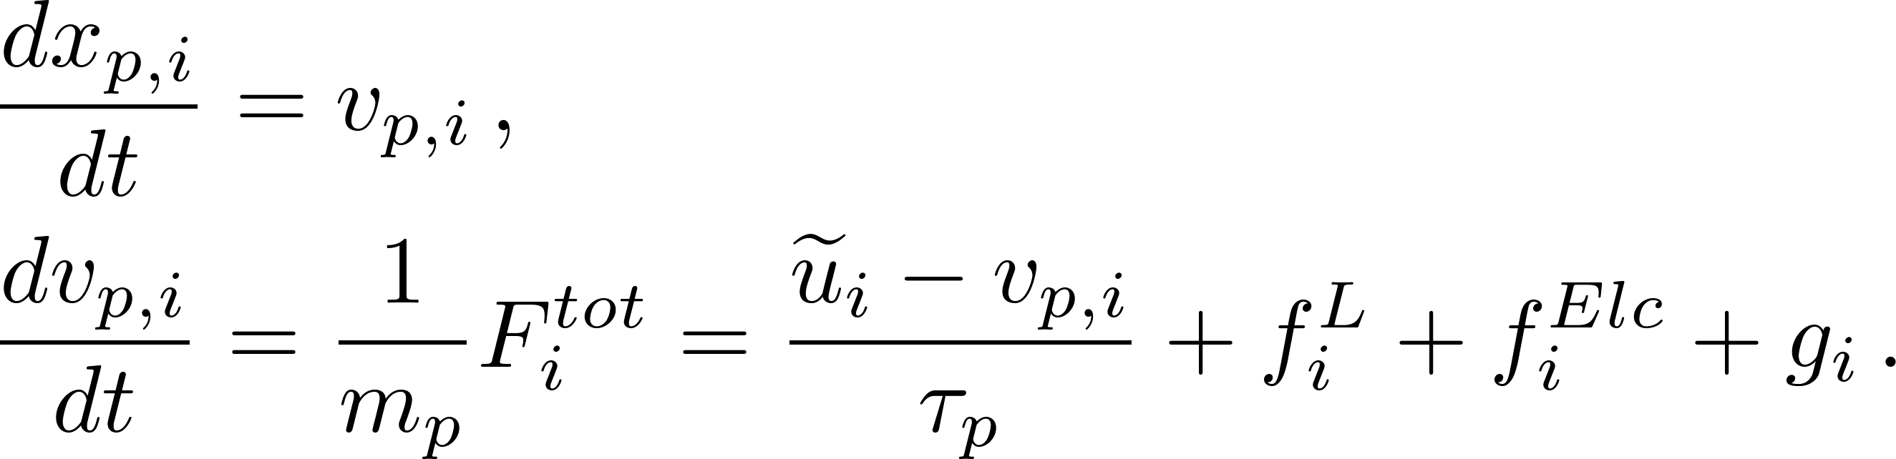
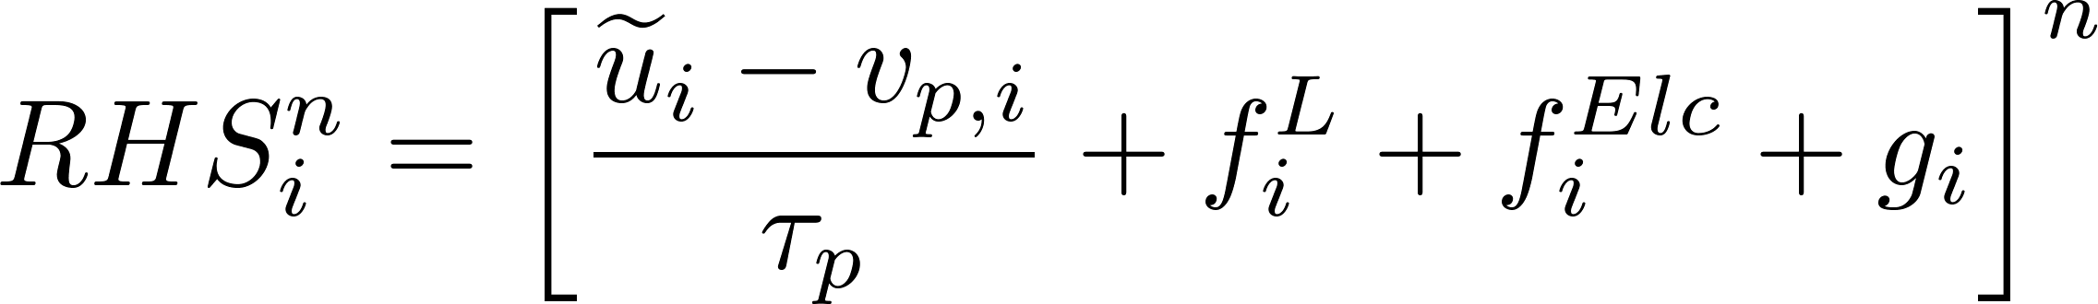
► Solve particle equation of motion (update position and velocity)
Which has to be known beforehand:
include parameter.f ( nodes number, particles number)
common/dim/n1,n1m,n2,n2m,n3,n3m
common/d13/ alx1, alx3 (dimensions in spanwise and longitudinal periodic directions)
common/tstep/ Δt, reynolds number
common/pdensity/ rof ?
common/ bulk-velocity/ Ub ?
common/half channel/ delta ?
dimension q(3, m1, m2, m3)
common/pdensity/ rop
common /part/np, dp ( number of particles and particle diameter)
common/partcoord/ x1(mp), x2(mp), x3(mp) ( mp: total number of particles)
common/partvelo/vp1(mp), vp2(mp), vp3(mp)
common/pintvel1/vf1(mp), vf2(mp), vf3(mp)
CALL RELATIVEVELOCITY(n_begin,n_end)
CALL COEFDRAG(n_begin,n_end)
CALL DRAGFORCE(n_begin,n_end)
CALL SAVEDRAGFORCE(n_begin,n_end)
if (n_Saffman_lift.eq.1) then
CALL LIFTFORCE(q,n_begin,n_end)
CALL SAVELIFTFORCE(n_begin,n_end)
end if
CALL SAVE_PARTICLE_VELOCITY(n_begin,n_end)
CALL UPDATE_PARTICLE_VELOCITY(n_begin,n_end,ga,ro)
CALL SAVE_PARTICLE_POSITION(n_begin,n_end) !-update-particle-position-include-wall-choc-inside----!
CALL UPDATE_PARTICLE_POSITION(n_begin,n_end,ga,ro,ntime)
Resolution of RHS member
Fluid velocity interpolated at particle location

